Slide 1
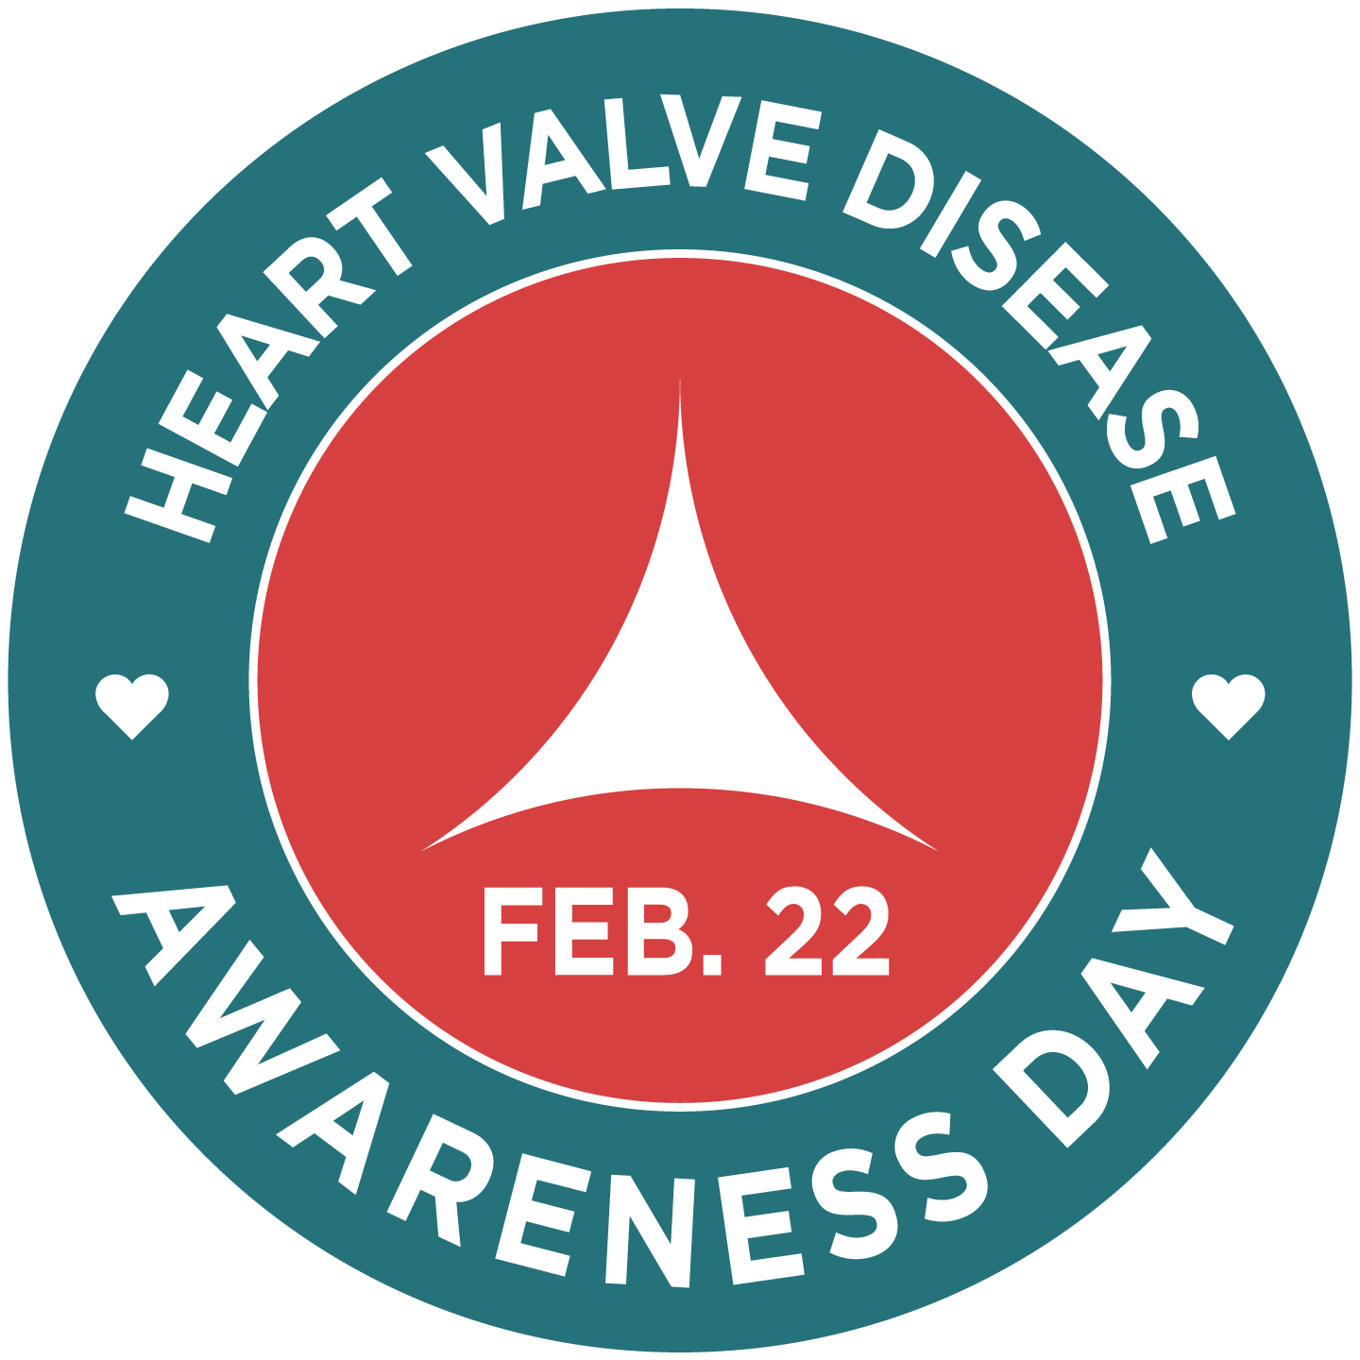
www.ValveDiseaseDay.org

Slide 2
INSERT YOUR LOGO HERE
www.ValveDiseaseDay.org

Slide 3
INSERT YOUR LOGO HERE
www.ValveDiseaseDay.org

Slide 4
Download the video
INSERT YOUR LOGO HERE
www.ValveDiseaseDay.org

Slide 5
Age – 1 in 10 people ages 75+ have heart valve disease
Previous or existing heart conditions – e.g. infective endocarditis, rheumatic fever, heart attack, heart failure, and atrial fibrillation
Risk factors for coronary heart disease – e.g. high cholesterol, high blood pressure, smoking, diabetes, obesity, lack of physical activity
Congenital birth defect – e.g. bicuspid or fused aortic valve

Slide 6
SYMPTOMS
People with valve disease do not always have symptoms, even with severe
disease. Others may have symptoms with less severe disease. They are NOT a
normal sign of aging and you should talk to an HCP if you experience
Shortness of breath
Weakness or dizziness
Pain, tightness, or discomfort in the chest
Fainting or feeling faint
Fatigue
Rapid or irregular heartbeat
Lightheadedness
Decrease in exercise capacity
Swollen abdomen or ankles & feet
INSERT YOUR LOGO HERE
www.ValveDiseaseDay.org

Slide 7
DIAGNOSIS
If you have symptoms or a heart murmur, your health care professional may order other tests to diagnose heart valve disease:
Echocardiography
Electrocardiogram
Chest x-ray
Cardiac catheterization
Stress test
Cardiac MRI
INSERT YOUR LOGO HERE
www.ValveDiseaseDay.org

Slide 8
TREATMENT
There are no medicines to cure heart valve disease, but your health care professional may prescribe medication to treat symptoms or other conditions that might lead to heart valve disease.
Fortunately, heart valve disease can usually be successfully treated with repair or replacement in patients of all ages.
Studies show replacement is even safe and effective for patients over age 90!
INSERT YOUR LOGO HERE
www.ValveDiseaseDay.org

Slide 9
INFO ABOUT YOUR HOSPITAL/HEART CENTER/INSTITUTE
INSERT YOUR LOGO HERE
www.ValveDiseaseDay.org

Slide 10
